Slide 1
.NET Platform 2017 Overview

Slide 2

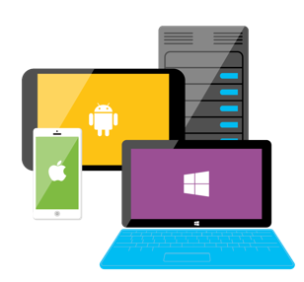






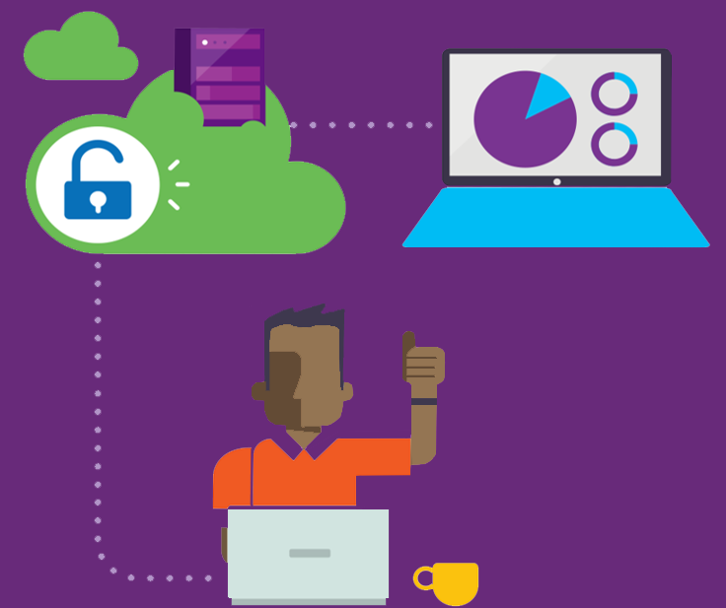
ASP.NET
Azure
Innovation
Any app, any platform
Open Source
Notes:
Innovation: Innovate and deliver much more faster
Openness enriches the platform and the community
On any device and platform

Slide 3
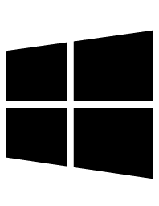


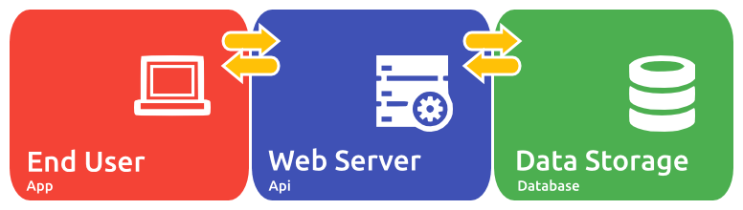






Sample Ecosystem
Mobile
Webs, Apps & Games
Server & Desktops
Services, Apps & Games
Browser
Webs, Apps & Games
Entertainment
Webs, Apps & Games

Slide 4

C#
C# is an elegant, type-safe, object-oriented, scalable, state of the art programming language that run on the .NET Framework
Run on 2.6 billion devices.
With C# and Visual Studio, you can share the same code on iOS, Android, Windows, Mac and more.
Write C#. Create Apps, Webs, Games and Services for all major OS, like Windows, Linux, OSX

Slide 5
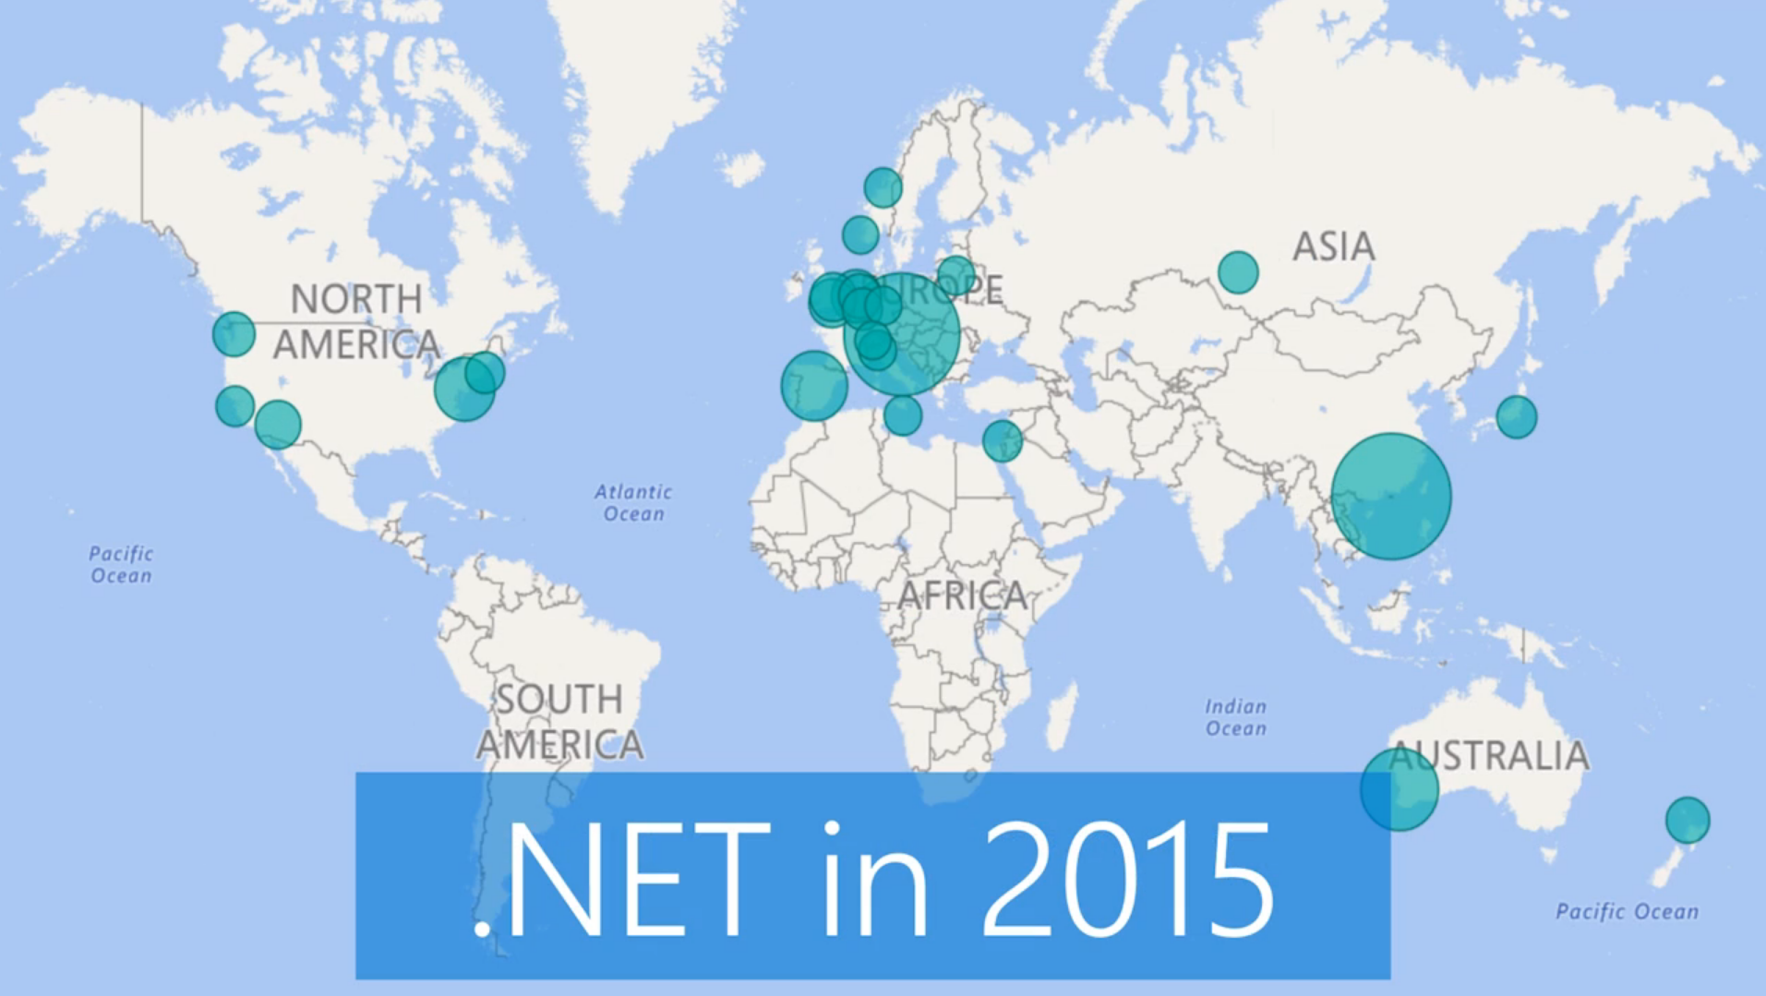

Slide 6
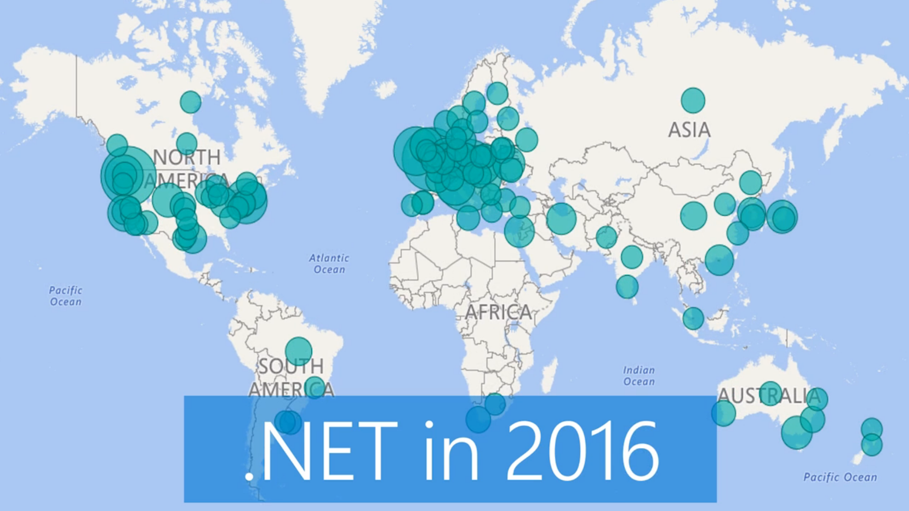

Slide 7
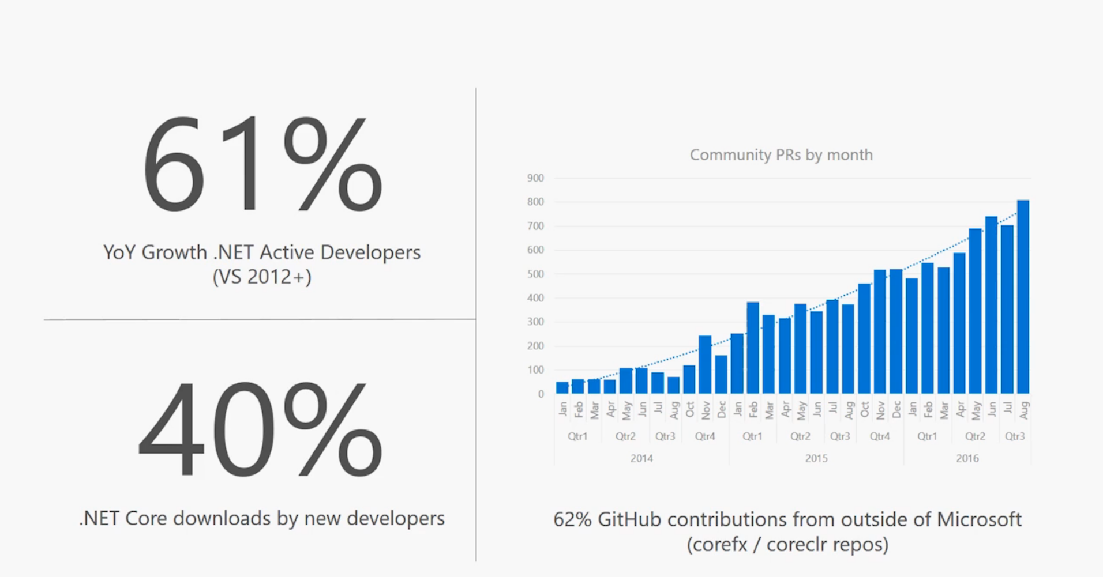

Slide 8



The big picture of .NET Platforms
.NET Framework
.NET Core
Xamarin
Application Models
WPF
ASP.NET 4.6
Win Forms
Universal Windows Apps 10.1
ASP.NET Core 1.1
Android 7.0
iOS 10.4
Mac 3.0
Base Libraries
Base Class Library
CoreFX
Mono BCL
Common
Runtime Components
Compilers
NuGet packages
Next gen JIT (RyuJIT)
SIMD
Languages innovation
.NET Compiler Platform
.NET Core 1.0 Libraries
.NET Framework 4.6 Libraries

Slide 9
Revisiting .NET Platforms
.NET Framework
.NET Core
Xamarin
Application Models
WPF
ASP.NET 4.6
Win Forms
Universal Windows Apps 10.1
ASP.NET Core 2.0
Android 7.0
iOS 10.4
Mac 3.0
Mono BCL
.NET Standard Library Based on .NET Standard
Base Libraries
Base Class Library
CoreFX
Common
Runtime Components
Compilers
NuGet packages
Next gen JIT (RyuJIT)
SIMD
Roslyn
.NET Compiler Platform
.NET Core 2.0 Libraries
.NET Framework 4.6 Libraries

Slide 10
.NET Standard 2.0
Introduces more APIs
Creates compatibility with .NET Framework libraries
Compatibility shim bridges .NET Standard based libraries to .NET FX libraries (mscorlib)
Version | #APIs | Growth %
1.x | 13,501 | +1%
2.0 | 32,638 | +142%
XML
XLinq • XML Document • XPath • Schema • XSL
SERIALIZATION
BinaryFormatter • Data Contract • XML
DATA
Abstractions • Provider Model • DataSet
NETWORKING
Sockets • Http • Mail • WebSockets
IO
Files • Compression • MMF
THREADING
Threads • Thread Pool • Tasks
CORE
Primitives • Collections • Reflection • Interop • Linq
Notes:
https://github.com/dotnet/standard/tree/master/docs/netstandard-20
https://github.com/dotnet/standard/blob/master/docs/netstandard-20/packaging.md
https://blogs.msdn.microsoft.com/dotnet/2016/05/27/making-it-easier-to-port-to-net-core/

Slide 11
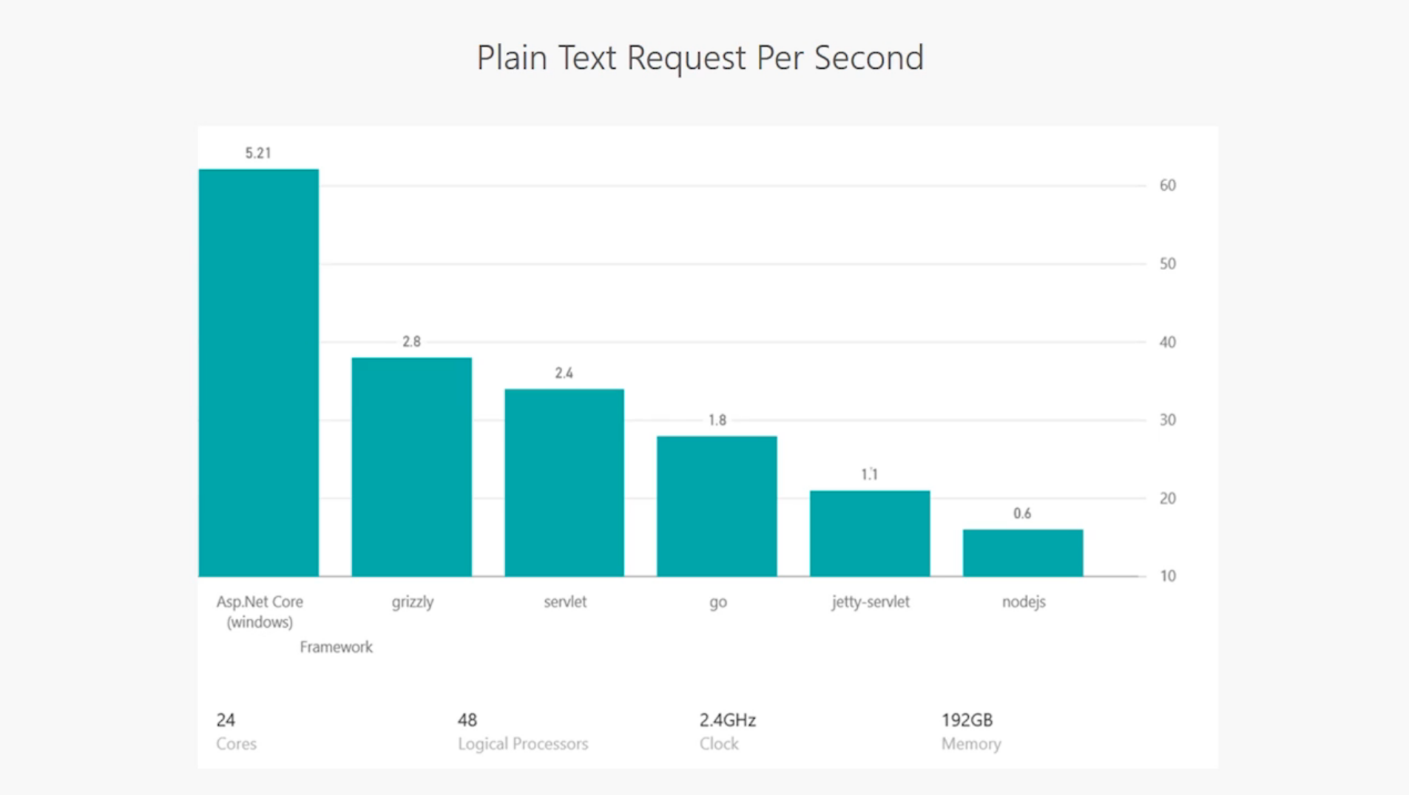

Slide 12
Multi-targeting and multiple runtimes
Compile for targets frameworks
.NET Core applications netcoreapp1.0
.NET Standard Libraries netstandard1.6
.NET Full Framework net46
More frameworks and TFMs
Runtimes for supported Operating Systems
Growing list
ARM support in works
Identified by RID
Linux
CentOS 7.1+
Debian 8.2+
Fedora 23
Linux Mint 17.1, 18
OpenSUSE 13.2, 42.1
Oracle Linux 7.1
Ubuntu 14.04 & 16.04
Mac OS X 10.11, 10.12
Windows
Windows Nano Server TP5
Windows Server 2016
Red Hat Enterprise Linux 7.2
Windows 7+ / Server 2012 R2+
Windows Server Core

Slide 13
Demo Hello World in .NET Core
Notes:
Key observations:
.csproj is back
New MSBuild implementation for .NET Core projects
Definitions for:
Targets: targeted .NET platforms and standards
Dependencies: required assets from NuGet packages
Runtimes: specific operating systems
Command-line tooling
.NET CLI: dotnet.exe and extensions

Slide 14
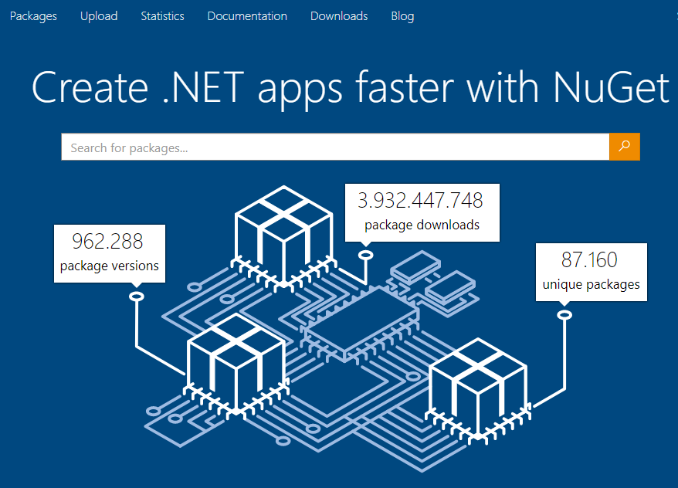


NuGet is the package manager for .NET. The NuGet client tools provide the ability to produce and consume packages. The NuGet Gallery is the central package repository used by all package authors and consumers.
Notes:
Innovation: Innovate and deliver much more faster
Openness enriches the platform and the community
On any device and platform

Slide 15
Demo Using GitHub & NuGet

Slide 16





Software delivery challenges
DEVELOPERS
IT OPS
BUSINESS
40
%
of implementations end up…
The average hourly cost of infrastructure failure is
3/4
of teams…
$100k
per hour
getting reworked because they don’t meet the users’ original requirements
It takes on average 200 minutes to diagnose and repair a production issue
have adopted
Agile methodologies
Notes:
In the real world, there are real consequences if companies are unable to deliver high-quality software quickly or build the wrong thing to begin with: (CLICK)
40% of implementations end up getting reworked because they don’t meet the users’ original requirements. (CLICK)
The average cost of one hour downtime of a customer-facing app is calculated at 100.000 dollars per hour – and this does not take into account the damage to reputation, which can be even greater. Fixing such production issues takes on average 200 minutes per incident. (CLICK)
Three quarters of development teams have adopted Agile methodologies today, enabling them to develop faster. While this is a great number, it does not help if a development team is Agile but deployment still takes weeks or months. (CLICK)
These are just 3 examples but all the data we have today points toward one conclusion – this is about more than just frustration or minor delays. Lack of collaboration between dev and ops can have substantial impact on a company’s bottom line and success.

Slide 17
Agility & DevOps
Plan + Track
Release
Development
Production
Develop + Test
Monitor + Learn
Notes:
We are now in the second decade of Agile – and development teams have become extremely efficient at developing software faster with agile practices.
But what we still see are two distinct lifecycles: application development and operations, which – very often – are not in sync.
For us, DevOps has always been about unifying those two worlds.
A converged DevOps lifecycle gives you the ability to execute on ideas quickly and iterate on feedback rapidly, with minimum friction while at the same time maintaining the highest level of quality.
This is our definition of DevOps – in encompasses the entire cycle, from initial idea to finished app running in production.

Slide 18

Agile Planning
Delivery plans
Dashboards
Kanban boards
Monitor and Learn
Application analytics
Logging & operations analytics
Mobile crash reporting
Monitor + Learn
Plan + Track
DevOps
DevOps
Build and Test
Git source control
Continuous integration
Security scanning
Open source compliance
Cloud-based device testing
Release
Develop + Test
Release
Continuous delivery
Functional testing
Release management
Microsoft DevOps Solution
Visual Studio Team Services
Team Foundation Server
Application Insights
Visual Studio Mobile Center

Slide 19
A traditional look at DevOps
Code editing
Debugging
Unit testing
Code analysis
Source control
Continuous integration
Continuous deployment
public async Task<int>
{int x = await task;
<//>
Development flows left to right and repeats

Slide 20
FLOW OF CUSTOMER VALUE
TEAM AUTONOMY & ALIGNMENT
BACKLOG IMPROVED BY LEARNING
EVIDENCE GATHERED IN PRODUCTION
MANAGED TECHNICAL DEBT
PRODUCTION FIRST MINDSET
INFRASTRUCTURE IS A FLEXIBLE RESOURCE
Recommended DevOps Practices
Shift Left Continuous Integration Continuous Testing Continuous Deployment | Self-Managing Teams Feature Crews Enterprise Agile | Continuous Learning Testing in Production Continuous Feedback | Experiments Usage Monitoring Telemetry Collection Testing in Production Continuous Feedback | Code Quality Analysis Peer Code Reviews Automated Testing Architecture Validation Continuous Testing | Continuous Testing Continuous Deployment App Performance Mgmt. Infrastructure as Code Automated Recovery | Cloud Infrastructure Developer Sandbox Cloud Dev and Test Infrastructure as Code Automatic Scaling
Visual Studio Features
Live Experiences Live Unit Testing Live Dependency Validation Flexible Source Control Modern Code Workflows Cross-Platform Build Automated Testing Release Management Code Coverage Intellitest Fakes and Stubs Redgate ReadyRoll Redgate SQLPrompt | Agile Tools Enterprise Collaboration Dashboards & Charts | Test & Feedback Application Insights HockeyApp IntelliTrace in Production Performance Testing | Test & Feedback Application Insights HockeyApp IntelliTrace in Production Performance Testing | Modern Code Workflows Pull Requests Test & Feedback Automated Testing Live Experiences Live Unit Testing Live Dependency Validation IntelliTest IntelliTrace Code Maps Visual Debugging Code Analysis Code Coverage Redgate ReadyRoll Redgate SQLPrompt | Automated Testing Test & Feedback Application Insights HockeyApp Release Management Performance Testing | Cloud Dev/Test Env. Azure Dev/Test Labs Azure VMs Azure App Service Performance Testing
Notes:
If an organization adopts even just one of the DevOps practices listed on the previous slide, it will have a positive impact on their ability to deliver better software, faster.
If you looking to adopt DevOps, we recommend that you start with a few well-established practices – these are widely recognized as the basis of many successful DevOps transformations. (CLICK)
But in order to be successful with DevOps practices, powerful DevOps tools are required.
You can get different tools for all the tasks and steps of the end-to-end DevOps pipeline and wire them together as needed. (CLICK)
However, with Visual Studio Enterprise, .NET developers get the tools and services for all phases of the end-to-end lifecycle out of the box.
And even if you do not want to use just Microsoft tools and technologies, you can easily integrate any existing tool with our DevOps solution.

Slide 21
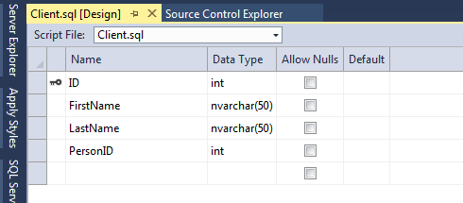
Azure Sql Database – Data Storage

Slide 22
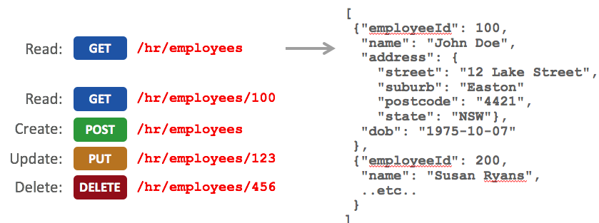
Azure App Service - Web API

Slide 23
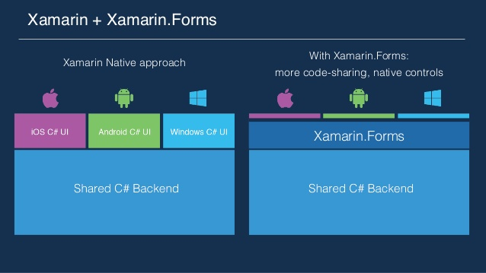

Slide 24
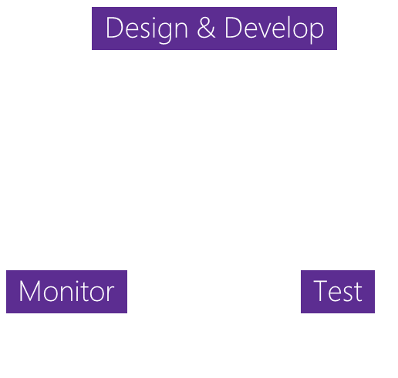


Mobile Development Challenges
SCALABILITY
COMPLEXITY
FRAGMENTATION
+ Apps
Businesses need to rapidly build and deliver high-quality mobile apps
App Delivery
The lifecycle to deliver ‘just one’ app involves many stages
+ Devices
Mobile ecosystems are complex with many combinations of devices

Slide 25
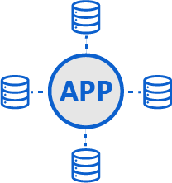
Mobile Apps are Complex
Authentication
Cloud Services
Phone & Tablet
Backend applications
Offline data
Application monitoring

Slide 26
Demo Xamarin.Forms

Slide 27
Demo Architecture
Azure
Mobile
Apps

Slide 28
Resources
https://www.visualstudio.com/es/dev-essentials/
https://www.microsoft.com/net/core
https://www.visualstudio.com/es/
https://github.com
https://www.nuget.org/
https://xamarin.com
http://datos.gob.ar/acerca/desarrolladores

Slide 29
Questions and Answers
¿¿??
C#

